Slide 1
UNDERWATER WIRELESS COMMUNICATIONS
SEMINAR GUIDE: PRESENTED BY:
Mrs.R.Sailakshimi, K.Ashish,
Asst.Professor. 15P31A0481,ECE-B.

Slide 2
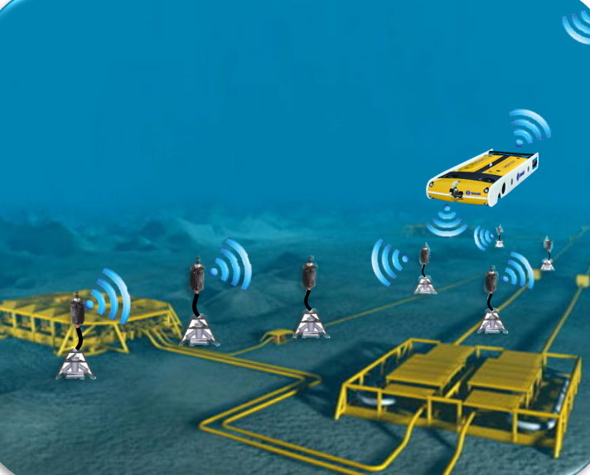
CONTENTS
Introduction
History
Technology
Construction
Advantages
Limitations
Applications
Conclusion

Slide 3
INTRODUCTION
Underwater wireless communication is the wireless communication in which acoustic signals will carry digital information through a under water channel. Electromagnetic waves are not used as they propagate short distances.

Slide 4
HISTORY
The science of under water acoustics begin in1490,when LEONARDO DA VINCI started.
In 1687 ISAAC NEWTON wrote his mathematical principles of natural philosophy which include the first mathematical treatment of sound in water.

Slide 5
TECHNOLOGY
Underwater communications are based on ACOUSTIC LINKS characterized by large propagation delays.
Acoustic channels have LOW BANDWIDTH.
The propagation speed of acoustic signals in water is typically 1500 m/s.
It cannot rely on the Global Positioning System (GPS).

Slide 6
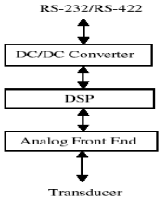
ACOUSTIC MODEM
Employ advanced modulation scheme and channel equalization for improved signal to noise ratio.
PARTS OF ACOISTIC MODEM:
DSP Board
AFE (Analog Front End) board
DC/DC Converter

Slide 7
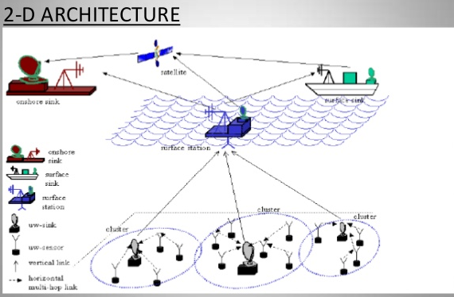
ASN COMMUNICATION ARCHIRECTURE

Slide 8
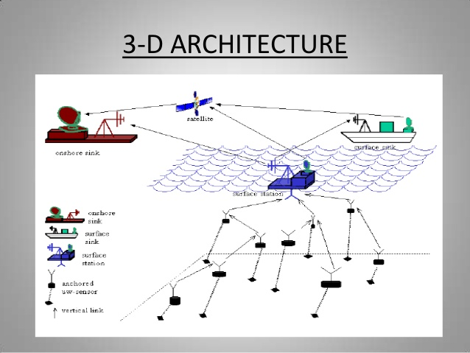
3-D ARCHITECTURE

Slide 9
ADVANCE MODEMS AVAILABLE

Slide 10
ADVANTAGES
It avoids data spoofing
Avoids privacy leakage
Minimize communication and computational cost
Maximizes the battery power by preserve the power of under water sensors.

Slide 11
LIMITATIONS
Limited battery power
Underwater sensors are prone to failure because of corrosion,fouling, etc.
Highly effected by environmental and natural factors.

Slide 12
APPLICATIONS
Ocean current monitoring
Pollution monitoring
Equipment monitoring and control
Solar powered AUV’s
Remotely operated vehicle(ROV)
Autonomous underwater vehicles(AUV)
Underwater navigation and tracking

Slide 13
CONCLUSION
The challenges of underwater communication can be overcome by regulating the sensors properly and using various CDMA spectrums. By focusing on the routing schemes for 3- dimensional and considering present situation we can utilize this technique more efficiently. The use of Wavelength Division Multiplexing is also a revolutionary step in this direction.

Slide 14
THANK YOU QUERIES??

